Slide 1
Work with Docker
Practical

Slide 3
How to Push Docker Image to Docker Hub
To push a Docker image to Docker Hub, you can follow these steps:
Create a Docker Hub Account:
To proceed, visit https://hub.docker.com and register for a Docker Hub account if you don’t already have one.
Creating an account will grant you a username and password that you can use for authentication purposes.

Slide 4
2. Tag the Docker Image: Before performing a Docker Push, it’s essential to ensure that your Docker image is properly tagged. You can assign a tag to an existing image using the following command:
docker tag <image-id> <docker-hub-username>/<image-name>:<tag>
Replace `<image-id>` with the ID or name of your local Docker image. `<docker-hub-username>` should be your Docker Hub username, `<image-name>` is the name you want to give to your image, and `<tag>` represents a specific version or label for the image.

Slide 5
3. Log in to Docker Hub: Use the following command to log in to your Docker Hub account from the command line:
docker login
You will be prompted to enter your Docker Hub username and password. 4. Push the Docker Image: Once logged in, push the tagged Docker image to Docker Hub using the command:
docker push <docker-hub-username>/<image-name>:<tag>
Replace `<docker-hub-username>`, `<image-name>`, and `<tag>` with the respective values you used

Slide 6
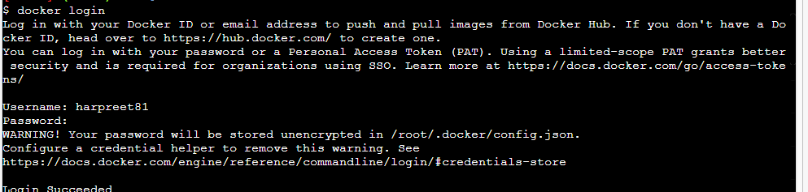
1. firstly find the images that you want to push in respository
2. Then use the login command to get login in docker hub as:

Slide 7
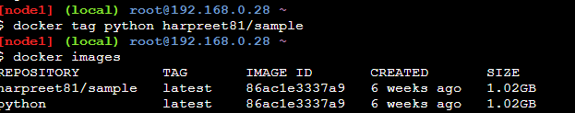
3. Then use tag command to give tag name to image :
Docker tag <image name> <tag name>

Slide 8
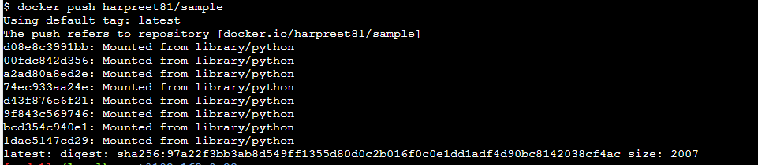
4. use push command
Docker push

Slide 9
Ex#2(Practice Question):
1.Update the ubuntu container, install apache and php, then push updated on to docker hub.
2. Compare the size of base image and updated image after commit

Slide 10
1. docker run –d –it –name a1 ubuntu
2. docker exec –it a1 bash
3. #: apk update
# apk add apache2
# apk add php
# exit
4. docker commit a1 harpreet81/ub-a:v1
5. docker login
6. docker push harpreet81/alpine-a:v1

Slide 11
To Build your own image from base image
Let's learn the concept of DOCKERFILE

Slide 12
To Create Docker Image by Docker file
Dockerfile:
Dockerfile is a simple text file that consists of instructions to build Docker images.
Mentioned below is the syntax of a Dockerfile:
Syntax
# comments
command argument argument1...
Example
# Print "Get Certified. Get Ahead"
Run echo "Get Certified. Get Ahead"

Slide 13
The specific commands you can use in a dockerfile are
FROM, PULL, RUN, and CMD
FROM - Creates a layer from the ubuntu:18.04
PULL - Adds files from your Docker repository
RUN - Builds your container
CMD - Specifies what command to run within the container

Slide 14
ENTRYPOINT allows specifying a command along with the parameters
ADD command helps in copying data into a Docker image
ADD /[source]/[destination]
ENV provides default values for variables that can be accessed within the container
ENV key value

Slide 15
Ex#1 : Create Ubuntu docker file
# Base Image
FROM ubuntu:latest
# Maintainer (optional )
LABEL maintainer="Student Demo"
# Install package
RUN apt update && apt install -y php
# Default command when container runs
CMD ["echo", "Hello Students"]

Slide 16
Ex#2: Create Java Docker file
$ mkdir java-docker
2. Create a Java File
Now create a Java file. Save this file as Hello.java file.
// Hello.java
class Hello{
public static void main(String[] args){
System.out.println("This is java app \n by using Docker");
}
}
Save it inside the directory java-docker as hello.java

Slide 17
3. Create a Dockerfile
FROM java
COPY . /var/www/java
WORKDIR /var/www/java
RUN javac Hello.java
CMD ["java", "Hello"]
4. Build Docker Image
After creating Dockerfile, we are changing working directory.
$ cd java-docker-app

Slide 18
5. $ docker build -t java-app .
6. $ docker run java-app

Slide 19
FROM java:8
COPY . /var/www/java
WORKDIR /var/www/java
RUN javac Hello.java
CMD ["java", "Hello"]

Slide 20
Few more commands in dockerfile:
WORKDIR Command
Sets the default directory inside container If directory does NOT exist → Docker creates it
All next commands execute inside this folder

Slide 21
COPY Command
Copies files/folders from host → container
Simple file transfer
No extra processing

Slide 22
ADD Command
Copies files
Auto extracts archives (.tar.gz)
Downloads files from URLs

Slide 23
RUN Command
Executes commands during image build
Creates new Docker layer
Used for installations & setup

Slide 24
Summary
WORKDIR → “Where work happens”
COPY → “Move files”
ADD → “Move files + magic”
RUN → “Execute commands while building image”

Slide 25
Docker file#3 for Python application
# 1. Base image
FROM python:3.11-slim
# 2. Set working directory
WORKDIR /app
# 3. Copy dependency file
COPY requirements.txt
.# 4. Install dependenciesR
UN pip install --no-cache-dir -r requirements.txt
# 5. Copy application code
COPY . .
# 6. Expose port
EXPOSE 5000
# 7. Run the app
CMD ["python", "app.py"]

Slide 26
App.py
from flask import Flask
app = Flask(_name_)
@app.route("/")
def home():
return "Hello from Docker!”
app.run(host="0.0.0.0", port=5000)

Slide 28
Types of Storage
in
Docker

Slide 29
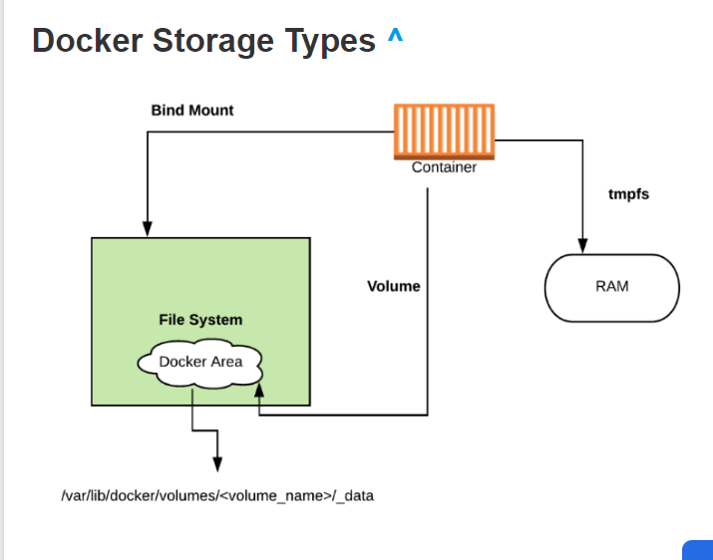

Slide 30
Docker storage distinguishes three storage types.
Two types are permanent: Docker volumes and bind Mounts
and the third way of writing data is tmpfs.
From the container perspective, it doesn’t know what sort of storage is in use.

Slide 31
The difference between these is, volumes have a dedicated filesystem on the host (/var/lib/ docker/volumes) and are directly controlled through the Docker CLI.
On the other hand, bind mounts use any available host filesystem.
Whereas tmfs, uses the host memory.

Slide 32
Docker Volume
Docker volume is the most commonly used technology for the permanent storage of container data.
Docker volume is managed by Docker itself and has a dedicated filesystem on the host, doesn’t depend upon the filesystem structure on the host.
Docker volumes are explicitly managed via the Docker command line and can be created alone or during container initialization. T
he command used is
docker volume create.

Slide 33
When stopping or deleting a container, Docker volume remains permanently stored.
The volumes are often manually deleted with the docker volume prune command.
Multiple containers can be connected to the same Docker volume.

Slide 34
Commands used for the Volumes
1. docker volume create
Used to Create a volume
2. docker volume inspect
Display detailed information on one or more volumes
3. docker volume ls
List volumes

Slide 35
4.docker volume prune
Remove all unused local volumes
5. docker volume rm
Remove one or more volumes

Slide 36
Some use cases for volumes include:
Sharing data among multiple running containers.
Volume is helpful if the Docker host is not guaranteed to have a given directory or file structure.
When you want to store your container’s data on a remote host or a cloud provider instead of storing locally.
Volumes are helpful if you need to back up, restore, or migrate data from one Docker host to another, volumes are a better choice

Slide 37
Docker Bind Mount
Docker bind mount is the second permanent storage option but with more limited options than Docker volume.
It can’t be managed via Docker CLI and is totally dependent on the availability of the filesystem of the host.
A host filesystem can be created when running a container. Bind mounts are a sort of superset of Volumes (named or unnamed).

Slide 38
tmpfs Mounts
tmpfs is a third storage option that is not permanent like Docker volume or bind mount.
The data is written directly on to the host’s memory and deleted when the container is stopped.
Very useful when it involves sensitive data that you simply don’t want to be permanent.

Slide 39
A really significant difference is that containers can’t share tmpfs space unless they’re running on Linux OS.
Two flags are used when creating tmpfs volume: tmpfs and mount.
Mount flag is newer and supports multiple options during containe startup.

Slide 40
Temporary filesystems are written to RAM (or to your swap file if RAM is filling up)
and not to the host or the container’s own filesystem layer at Docker.com: Docker tmpfs.

Slide 41
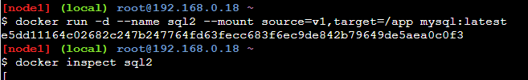

Slide 42
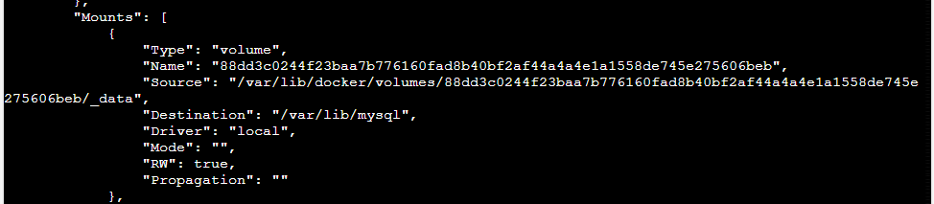

Slide 43
Ex#2:
We can manage volumes through the docker cli directly (unlike bind mounts)

Slide 44
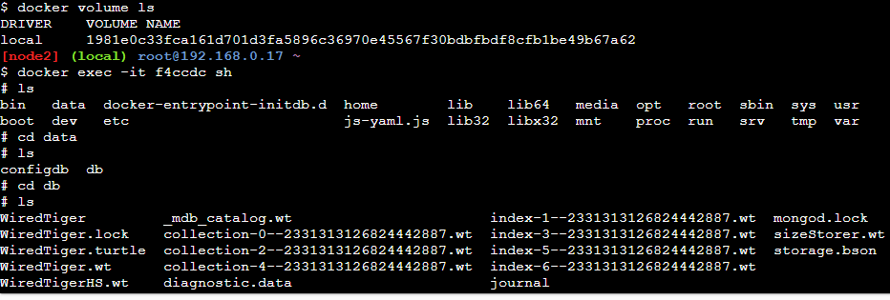

Slide 45
Practice question
1.Create the data in Ubuntu Image
2. Create the container with volume with name ubv1 and give path also where data will be stored.
3. Inspect the container running on ubuntu
4. Inspect the volume and path where data is stored.
5. Create one file inside the container in path specified with volume.
6. Delete the container.

Slide 46
7. Run one more container of ubuntu and check the data of previous container’s volume.
8. If available ok , otherwise restore the data of first container volume.

Slide 47
Practice questions
How the files can be shared among 2 different containers?
2.How the connectivity of 2 containers can be checked?
3. How do you Filter the images by reference, where the tag is "latest.“
4. How would you set the environment variables for the database connection details and application mode with help of run command?
5.

Slide 50
EX#3
echo "<h1>message from Host</h1>" > ./target/index.html
docker run -it --rm --name nginx -p 8080:80
-v "$(pwd)"/target:/usr/share/nginx/html nginx

